Slide 1
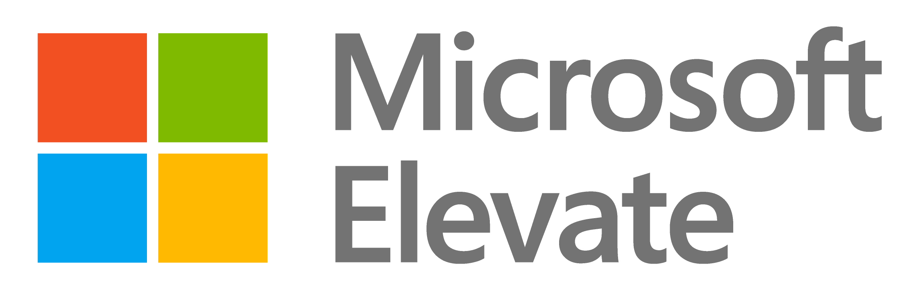

CAPSTONE PROJECT
Netflix Content Analytics Dashboard using Power BI
Presented By
Student Name: PRADEEP P
College Name: PSNA COLLEGE OF ENGINEERNG AND TECHNOLOGY
Department: BE-EEE
EMAIL ID := pradeepp26ee@psnacet.edu.in

Slide 2
OUTLINE:
Problem Statement (Should not include solution)
Proposed System/Solution
System Development Approach (Technology Used)
Algorithm & Deployment
Result (Output Image)
Conclusion
Future Scope
References

Slide 3
Problem Statement:
Streaming platforms like Netflix contain a vast amount of content including movies and series across multiple genres, languages, and countries. Analyzing such large datasets manually makes it difficult to understand viewing trends, content distribution, and audience preferences. There is a need for an analytical system that can visualize Netflix data effectively to identify patterns such as genre popularity, language distribution, ratings, and content trends.

Slide 4
Proposed Solution:
Streaming platforms like Netflix contain a vast amount of content including movies and series across multiple genres, languages, and countries. Analyzing such large datasets manually makes it difficult to understand viewing trends, content distribution, and audience preferences.
There is a need for an analytical system that can visualize Netflix data effectively to identify patterns such as genre popularity, language distribution, ratings, and content trends.
Proposed System / SolutionThe proposed system aims to analyze and visualize Netflix content data to help users understand content distribution, identify popular genres, and explore patterns across languages, age ratings, and release years. This system uses data analytics and interactive visualization techniques to transform raw streaming data into meaningful insights. The solution will consist of the following components:
Data Collection Gather historical Netflix dataset containing information such as title, genre, language, age rating, release year, country, and content type (movie or series).The dataset may also include additional information such as IMDb ratings and global distribution of content.
Data Preprocessing Clean and preprocess the collected dataset to handle missing values, duplicate entries, and inconsistent data formats.Perform data transformation and formatting to prepare the dataset for effective analysis and visualization.
Data Analysis Analyze Netflix content data to identify trends, patterns, and relationships between genres, ratings, and release years.Calculate statistical measures such as total number of titles, genre distribution, language distribution, and age rating analysis.
Data Visualization Develop an interactive dashboard using Microsoft Power BI to present Netflix data through various visualizations.Use charts such as bar charts, line charts, pie charts, treemaps, maps, and KPI indicators to display content trends, genre popularity, language distribution, and geographic availability.

Slide 5
System Approach:
The project was developed using Business Intelligence and Data Visualization techniques.
Technologies Used
Microsoft Power BI
Data visualization and dashboard development
Interactive charts and analytics
Microsoft Excel
Data storage and dataset management
Dataset preparation and organization
Power Query
Data cleaning and transformation
Handling missing values and formatting data
Data Visualization Techniques
Line charts, Bar chart, Pie charts. Treemaps, Maps, KPI indicators
These technologies enable effective analysis and visualization of Netflix streaming content data.

Slide 6
Algorithm & Deployment:
Data Collection Collected OTT platform data including Netflix, Amazon Prime, Disney+ and Hotstar with details like title, genre, release year, language, rating, and country.
Data Pre-processing Cleaned the dataset by removing missing values, correcting formats, and standardizing column names.
Data Transformation Used Power Query Editor to transform the data, split columns, and create calculated fields.
Data Modeling Built relationships between tables and created measures using DAX functions for analysis.
Data Visualization Designed interactive dashboards using charts such as Pie Chart, Map, KPI Cards, and Bar Charts
.
Insight Generation Analyzed the data to identify trends like popular genres, content distribution by country, and language preferences.

Slide 7
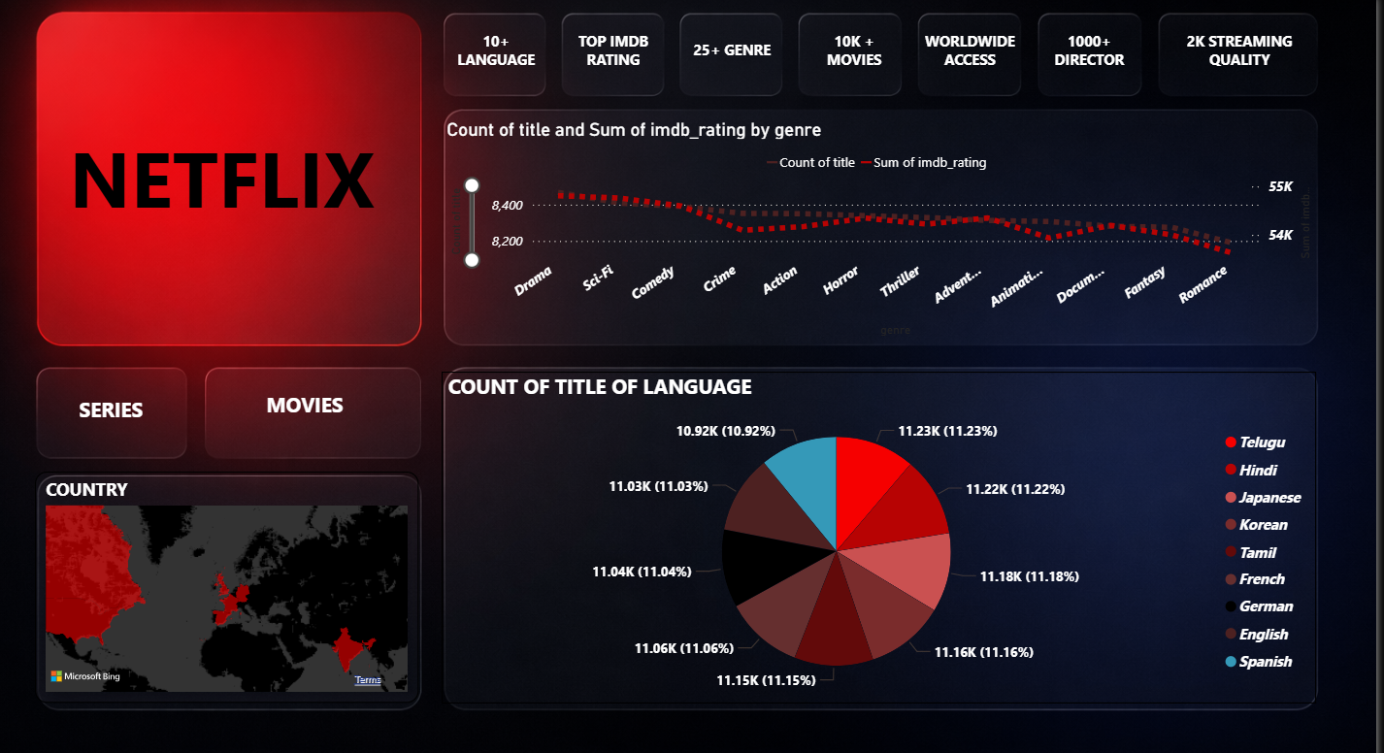
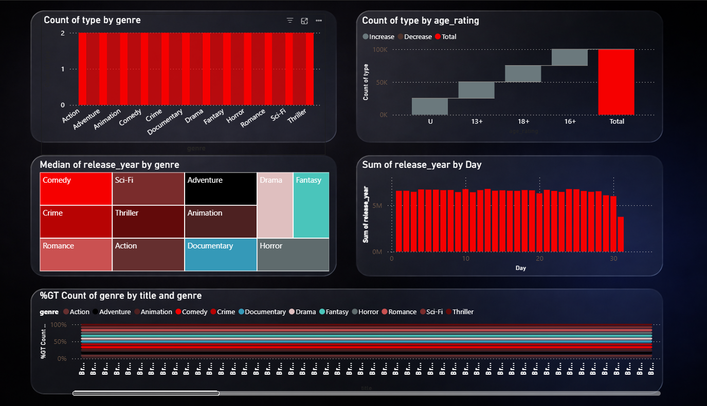
Result:
The dashboard contains three major sections:
Content Overview
Displays overall distribution of movies and series Shows key content indicators such as total titles and ratings Compares content distribution across genres
Content Analysis
Analyzes relationships between genre, age ratings, and language distribution Shows trends in content release across different years
Geographic Distribution
Displays country-wise distribution of Netflix content on a map Shows global availability of titles Identifies major regions contribution

Slide 8
Conclusion:
The *Netflix Content Analytics Dashboard* successfully demonstrates how streaming data can be analyzed using interactive visualizations. The dashboard helps users understand content distribution, compare genres and ratings, and identify trends across languages, countries, and release years. Using *Microsoft Power BI* simplifies complex datasets and provides meaningful insights for better understanding of Netflix content patterns.

Slide 9
Future scope:
Integration of real-time streaming data*
Machine learning models for content recommendation
Prediction of future content trends
Mobile-friendly dashboards
Integration with cloud platforms
Advanced analytics using Python or other data science tools
These improvements can help provide deeper insights into streaming content patterns and user preferences.

Slide 10
References:
Microsoft Power BI Documentation
Netflix Dataset Sources
Data Visualization Best Practices
Research articles on streaming platform analytics
Online resources for Power BI dashboard development
GitHub Link: https://github.com/pradeep161205/Netflix-Content-Analytics-Dashboard-using-Power-BI

Slide 11
Thank You

